Slide 1
Software Architecture Research and Development Project Synopsis
Building product lines from existing software

Slide 2
Who?
20074842, Lars Kringelbach, lars@kringelbach.com
20064684, Marjus Nielsen, Marjus.nielsen@gmail.com
20074877, Morten Herman Langkjær, morten.herman@gmail.com
20054680, Peter Madsen, pm@chora.dk

Slide 3
Abstract
The main focus of the project will be the task of converting existing software into a software product line.

Slide 4
Why?
We see a benefit in our organizations from converting specific software into a product line
Gain knowledge on the conversion process
Be able to pilot conversion projects
Be more efficient in the future

Slide 5
What?
The project will examine if it is feasible with a reasonable work effort to convert a “typical” representative of software not developed with a product line in mind into one.

Slide 6
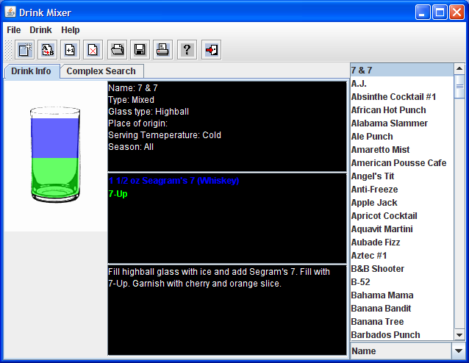
“Typical” ☺ representative

Slide 7
DrinkMixer
Open Source software
Reasonably sized
Suitable for a product line adaption
“Testing” will be fun ☺

Slide 8
Method
Small amount of architectural reconstruction
Apply theory
  Identification of variation points etc.
  Update architectural design

Slide 9
Evaluation
One architectural prototype used to measure the code difference between two instances of the product line
(a metric for effort)
Another architectural prototype used to evaluate the expected performance degration
Running aSQA to ensure that qualities does not degrade

Slide 10
Expectations
Exploration of patterns and architectural styles
Reuse
Measurement of required effort when creating a new product

Slide 11
Quality measurement
Wanted qualities should not degrade
aSQA will help us

